Slide 1
Biological Nanostructures : DNA and RNA
Presented by :
CHETHAN S -1RVU23CSE130
RISHEK J -1RVU23CSE376
MEGHA BILAGI -1RVU23CSE262
SRUSHTI DAYANAND DANGI -1RVU23USN474
Sem 1
Section – A
Btech CSE

Slide 2
BIOLOGICAL NANOSTRUCTRES
Biological nanostructures are structures at the nanoscale (typically ranging from 1 to 100 nanometers) that are found in living organisms. These structures play crucial roles in various biological functions and processes
biological nanostructures have useful in various fields, including medicine, biotechnology, and materials science.

Slide 3
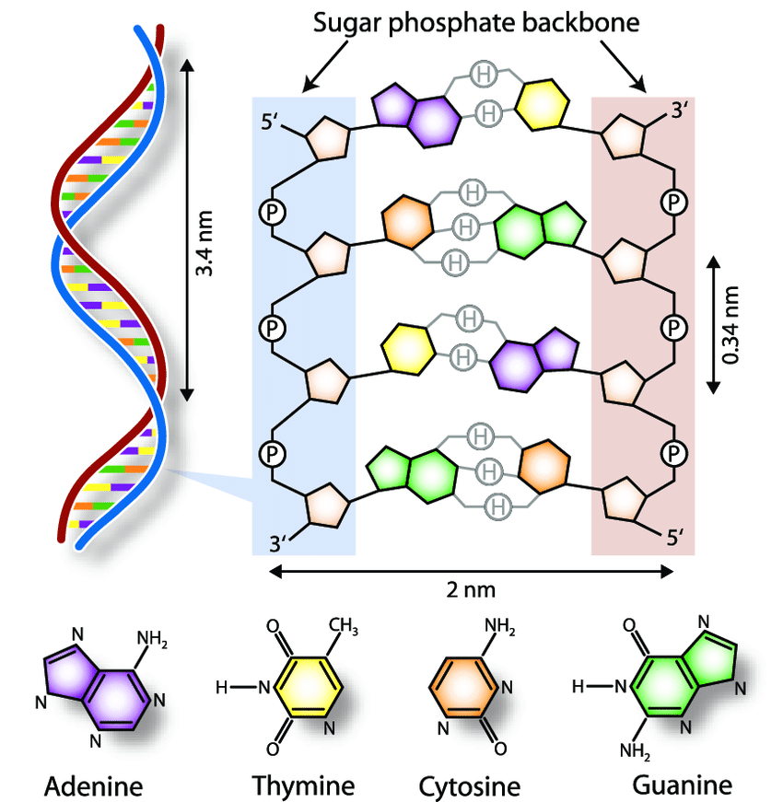
DNA structure and role of DNA in storing gentic information
DNA has a double-helix structure composed of two intertwined strands made of nucleotides. Each nucleotide consists of a sugar-phosphate backbone linked by phosphodiester bonds. Adenine pairs with thymine, and guanine pairs with cytosine, forming complementary base pairs connected by hydrogen bonds. The strands run antiparallel, with one in the 5' to 3' direction and the other in the opposite 3' to 5' direction.
Overall, this elegant double helix architecture provides stability and protects the genetic information encoded within DNA.
DNA, with its coded sequence, acts like a stable double helix, housing genetic instructions within genes on chromosomes. Through precise replication, it ensures accurate cell division and inheritance of traits. Additionally, DNA's role in protein synthesis is crucial for cellular functions, and mutations contribute to genetic diversity, fostering adaptation

Slide 4

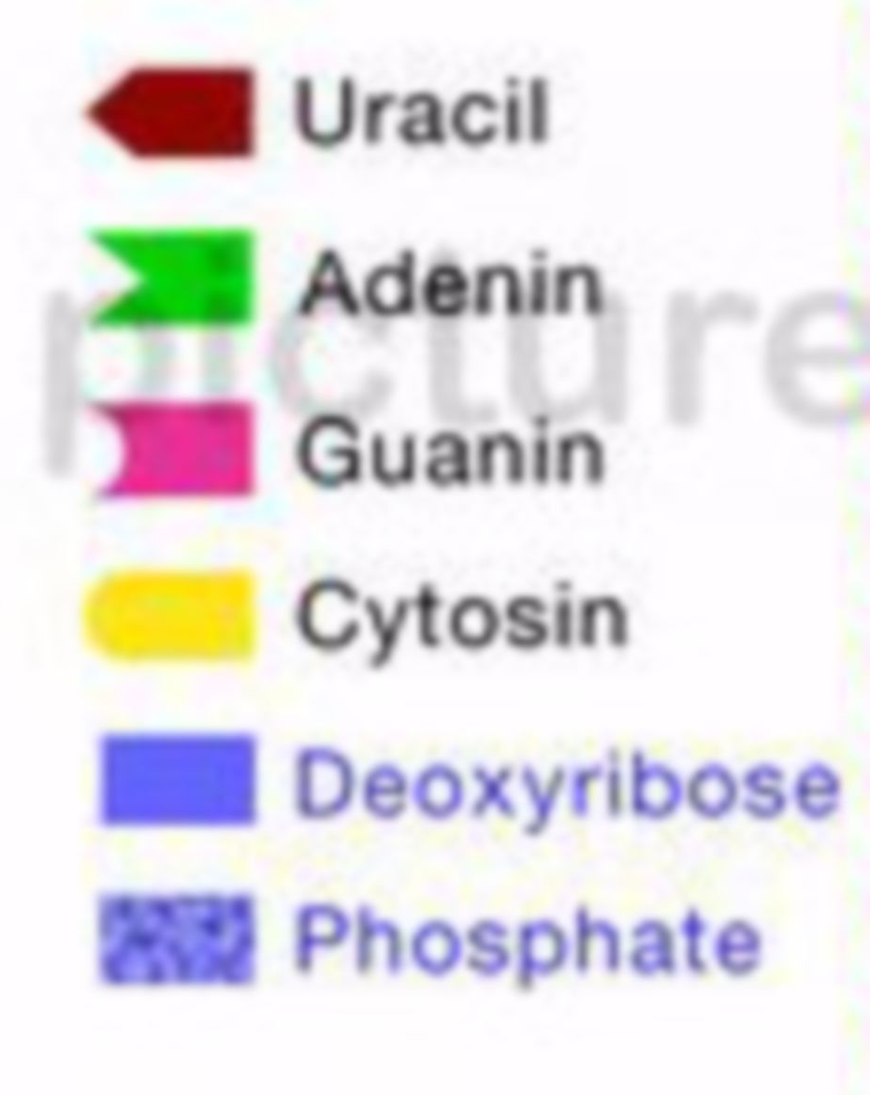
RNA INTRODUCTION
RNA, or ribonucleic acid, is a vital molecule involved in various cellular processes ,particularly in the synthesis of proteins. It shares some similarities with DNA (deoxyribonucleic acid) but differs in structure and function.
TYPES OF RNA
mRNA : transfer RNA bring amino-acids for the synthesis of protein.
rRNA : messenger RNA read the code from DNA for a specific protein
tRNA : ribosomal RNA is the part of ribosome and thus play a major role in the translation of code into protein.
DNA REPLICATION :
DNA replication is the process by which a cell makes an identical copy of its DNA, ensuring that genetic information is passed on during cell division.

Slide 5
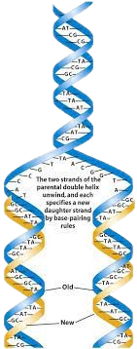
PROCESS OF DNA REPLICATION : Unwinding: The DNA double helix is like a twisted ladder. Enzymes called helicases unzip or unwind the DNA by breaking the hydrogen bonds between the paired bases. Separation: The two separated strands now act as templates. Free-floating nucleotides in the cell find their complementary bases on the exposed strands. Adenine (A) pairs with Thymine (T), and Cytosine (C) pairs with Guanine (G). Building: Enzymes called DNA polymerases link the nucleotides together to form two new strands, one for each of the original strands. This process follows the base-pairing rules, ensuring that the new strands are complementary to the original ones. Result: At the end of DNA replication, you have two identical double-stranded DNA molecules. Each new DNA molecule consists of one original strand and one newly synthesized strand.
TRANSCRIPTION AND TRANSLATION :
*Transcription is the synthesis of RNA from a DNA template where the code in the DNA is converted into a complementary RNA code.
*Translation is the synthesis of a protein from an mRNA template where the code in the mRNA is converted into an amino acid sequence in a protein

Slide 6
TRANSCRIPTION :
1.Initiation: RNA polymerase binds to the DNA at the beginning of a gene.
2.Elongation: RNA polymerase moves along the DNA, unwinding it and synthesizing a complementary RNA strand.
3.Termination: RNA polymerase reaches the end of the gene, and the newly formed RNA molecule is released
TRANSLATION:
1.Initiation: mRNA binds to a ribosome, and the process begins.
2.Elongation: tRNA brings amino acids to the ribosome based on the mRNA code.
3.Termination: Protein synthesis stops when a stop codon is reached.
Result: A functional protein is synthesized based on the mRNA code.
TRANSCRIPTION :
1.Initiation: RNA polymerase binds to the DNA at the beginning of a gene.
2.Elongation: RNA polymerase moves along the DNA, unwinding it and synthesizing a complementary RNA strand.
3.Termination: RNA polymerase reaches the end of the gene, and the newly formed RNA molecule is released
TRANSLATION:
1.Initiation: mRNA binds to a ribosome, and the process begins.
2.Elongation: tRNA brings amino acids to the ribosome based on the mRNA code.
3.Termination: Protein synthesis stops when a stop codon is reached.
Result: A functional protein is synthesized based on the mRNA code.
TRANSCRIPTION :
1.Initiation: RNA polymerase binds to the DNA at the beginning of a gene.
2.Elongation: RNA polymerase moves along the DNA, unwinding it and synthesizing a complementary RNA strand.
3.Termination: RNA polymerase reaches the end of the gene, and the newly formed RNA molecule is released
TRANSLATION:
1.Initiation: mRNA binds to a ribosome, and the process begins.
2.Elongation: tRNA brings amino acids to the ribosome based on the mRNA code.
3.Termination: Protein synthesis stops when a stop codon is reached.
Result: A functional protein is synthesized based on the mRNA code.
These processes are essential for transferring genetic information and creating the proteins necessary.
for the cell's structure and function

Slide 7
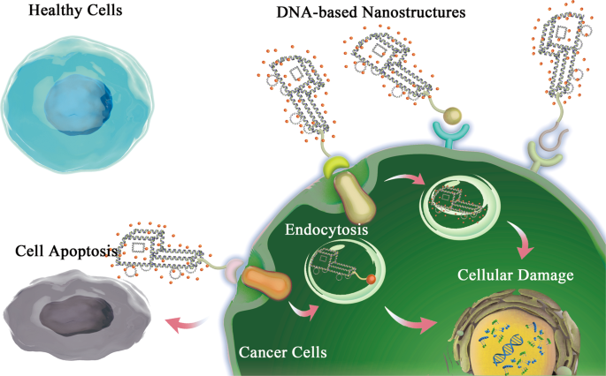
Applications and Implications :
Real-World Applications:
Genetic Engineering:
CRISPR-Cas9 that can be used to edit genes within the organisms.
Gene therapy using modified RNA.
Medical Advancements:
mRNA vaccines (e.g., COVID-19 vaccines).
DNA/RNA in diagnostics (PCR, gene sequencing).
Ethical Considerations:
Genetic Modification:
Deciding to create "designer babies" by picking specific traits raises ethical questions about playing with nature and fairness.
Medical Ethics:
Getting permission with full understanding before doing genetic testing to know and use your genetic information.
Privacy concerns in storing genetic information.

Slide 8
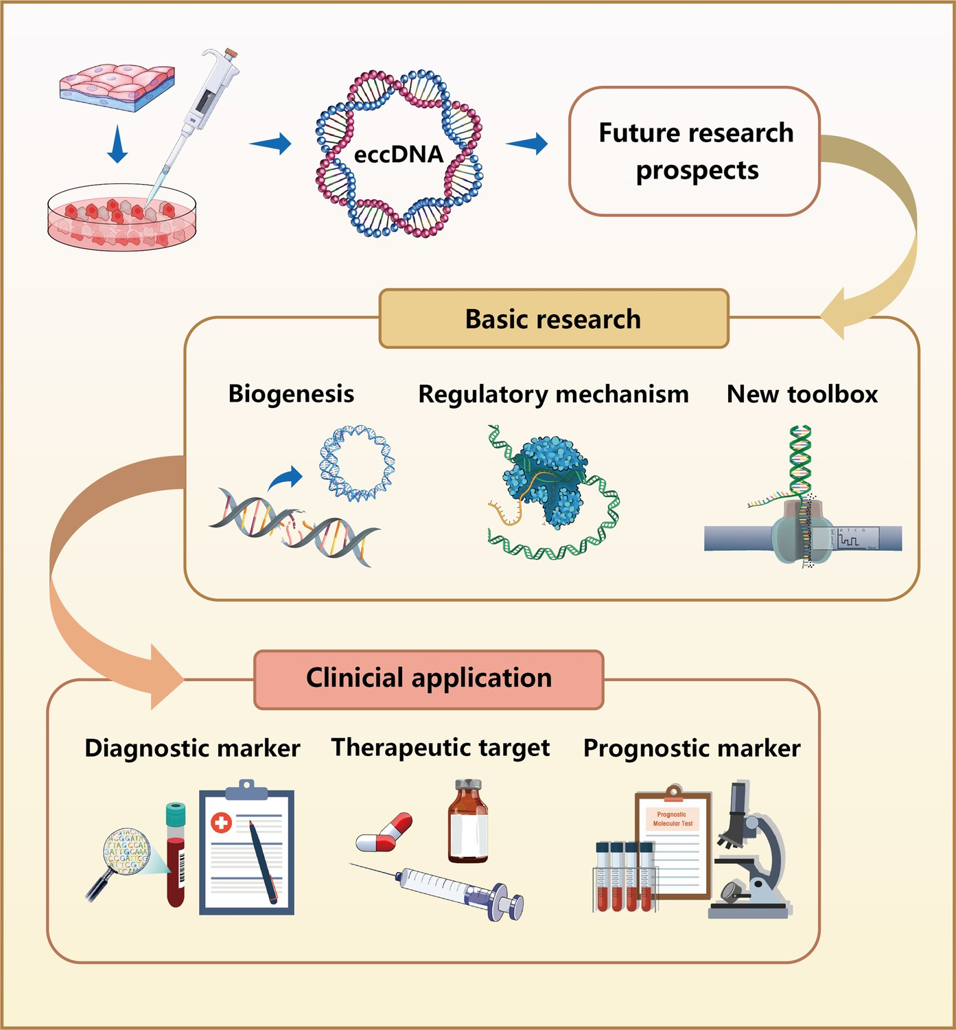
Future Prospects and Conclusion :
Nanomedicine Advances:
Tiny carriers made of DNA/RNA deliver medicine exactly where
needed. Extremely small robots do precise medical tasks for better
treatment.
Synthetic Biology:
Engineered DNA/RNA for creating new artificial life forms.
Biological Nanostructures Impact:
Revolutionizing genetic engineering and medicine.
Tiny biological structures change how we do genetics and medicine
Conclusion:
They're crucial for life's blueprint and have amazing potential for new technologies. Understanding them not only helps us grasp the basics of life but also opens the door to exciting innovations in medicine, farming, and technology."

